Slide 1

Ali Can ARIK
Görkem KANDEMİR
Hasan ATLI
DeusExMachina's Term Project

Slide 2
Outline
About Reversi
Data Structures
Details of Algorithm
Results
DeusExMachina's Term Project

Slide 3
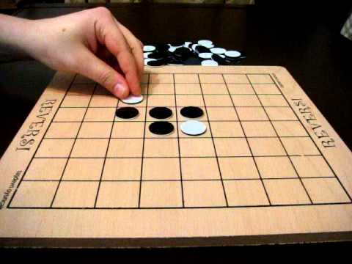
About Reversi
Strategy board game
Invented in 1883 in England
8x8 uncheckered board
DeusExMachina's Term Project

Slide 4

About Reversi
Modern version is called Othello
Inspired by Shakesperae’s play
DeusExMachina's Term Project
Notes:
Aşağıdaki hem ilginç bilgi hem zaman alır :D birde kural farklılıkları söylenebilir başlangıç pozisyonu zaten en önemlisi
The name was selected by Hasegawa^{[10]} as a reference to the Shakespearean play Othello, the Moor of Venice, referring to the conflict between the Moor Othello and Iago, and more controversially, to the unfolding drama between Othello, who is black, and Desdemona, who is white. The green color of the board is inspired by the image of the general Othello, valiantly leading his battle in a green field. It can also be likened to a jealousy competition (jealousy being the central theme in Shakespeare's play), since players engulf the pieces of the opponent, thereby turning them to their possession.

Slide 5
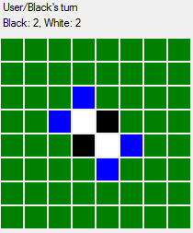
About Reversi
Why it is popular among artificial intelligence studies?
  2 player
  Zero sum
  Discrete
  Finite
  Deterministic
  Perfect Information
DeusExMachina's Term Project

Slide 6
Data Structures
Piece class
  Stores information about 1 square in the game board
  Members: value
  Methods: isBlack, isEmpty, getColor etc.
GameState class
  Stores information about game state
  Members: Back Pointer, 8x8 Piece array
  Methods: successor function, game tree generation function etc. (etc yi siledebiliriz)
DeusExMachina's Term Project
Notes:
Burada bu iki class detaylıca anlatılabilir

Slide 7
Details of Algorithm
MiniMax Algorithm
Alpha-Beta Pruning
Evaluation Function
DeusExMachina's Term Project

Slide 8
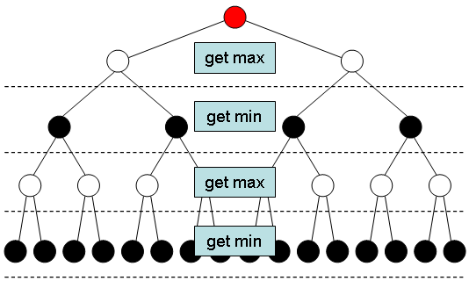
MiniMax Algorithm
Tries to maximize the possible gain for a worst case scenario
Search game tree using depth-first search approach
Has a constant search depth because of time constrains
DeusExMachina's Term Project

Slide 9
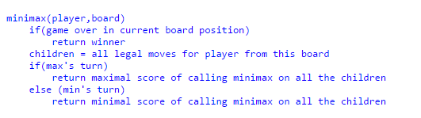
MiniMax Algorithm – Pseudo Code
DeusExMachina's Term Project

Slide 10
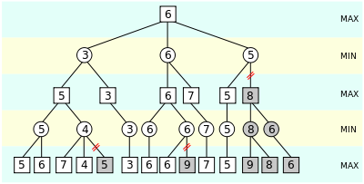
Alpha-Beta Pruning
Tries to decrease the number of nodes that are evaluated by the minimax algorithm
Prunes away branches that cannot influence the final decision
Very useful for Reversi since branching factor is too high
DeusExMachina's Term Project

Slide 11
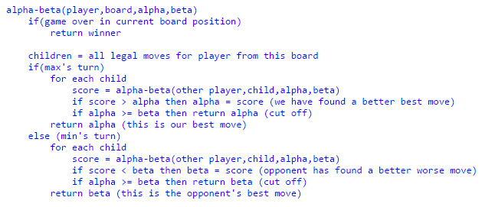
Alpha-Beta Pruning – Pseudo Code
DeusExMachina's Term Project

Slide 12
Evaluation Function
Weighted sum of 3 different component
  Maximum Disc Component
  Maximum Mobility Component
  Square Weight Component
Weights are changing during the game
DeusExMachina's Term Project

Slide 13
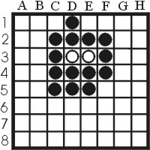
Maximum Disc Component
Greedy approach
Cause loss of mobility in early and mid game
Dominant at late game
DeusExMachina's Term Project

Slide 14
Maximum Mobility Component
Risky approach
Does not satisfy winning criteria
Dominant at early and mid game
DeusExMachina's Term Project

Slide 15
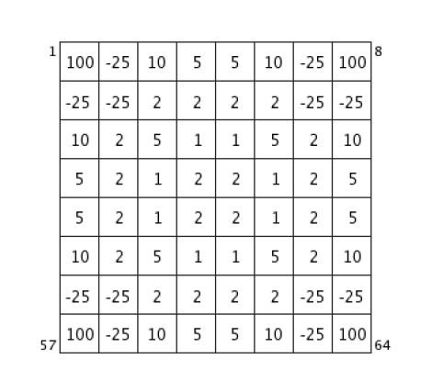
Square Weight Component
Not every square equal in value!
Dominant at all stages of the game
DeusExMachina's Term Project

Slide 16
Results
Performance measures for evaluating methods used are selected as:
  Number of nodes expanded
  Calculation time for move decision
DeusExMachina's Term Project

Slide 17
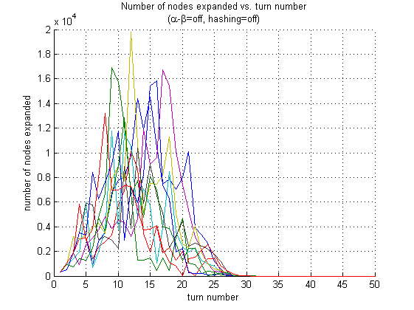
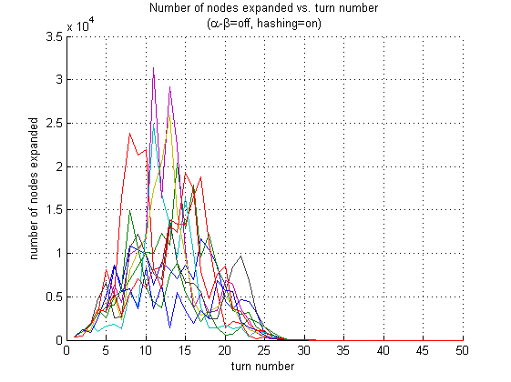
Results - Number of nodes expanded
DeusExMachina's Term Project

Slide 18
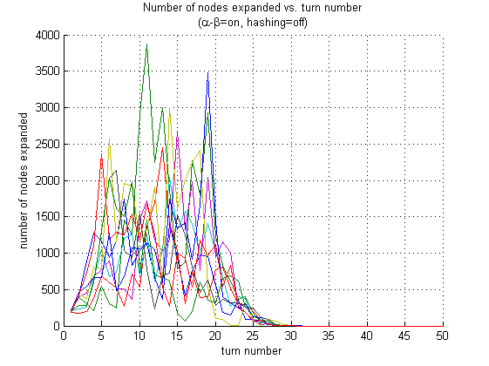
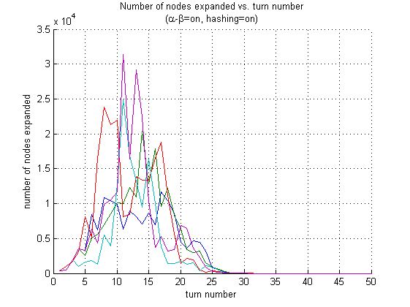
Results - Number of nodes expanded
DeusExMachina's Term Project

Slide 19
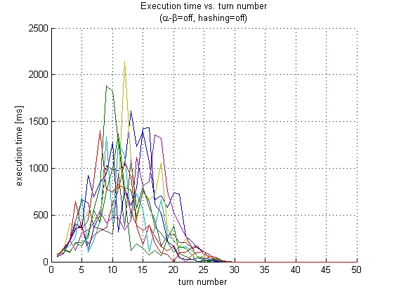
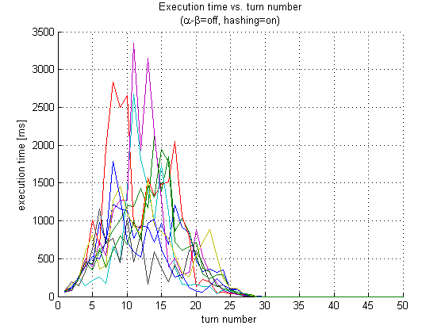
Results - Calculation time for move decision
DeusExMachina's Term Project

Slide 20
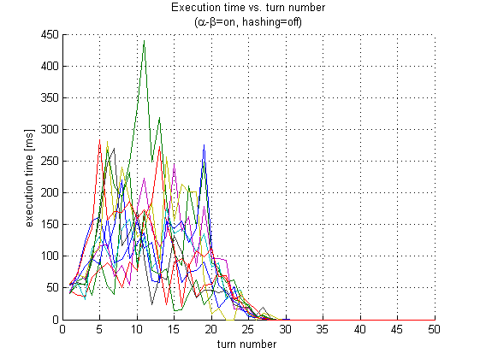
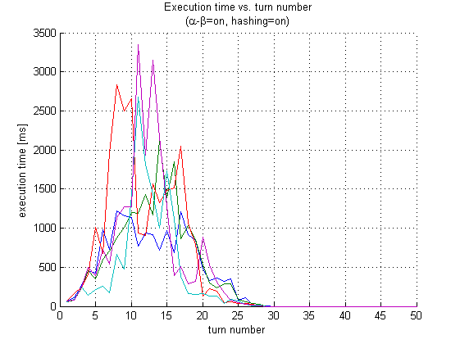
Results - Calculation time for move decision
DeusExMachina's Term Project

Slide 21
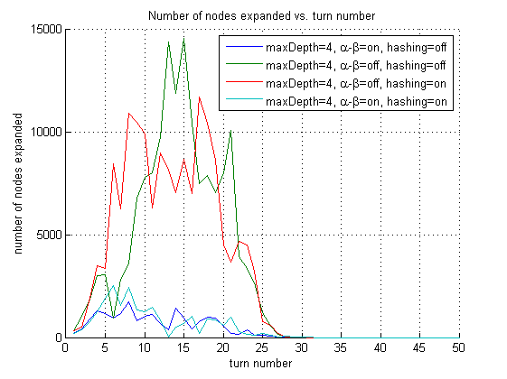
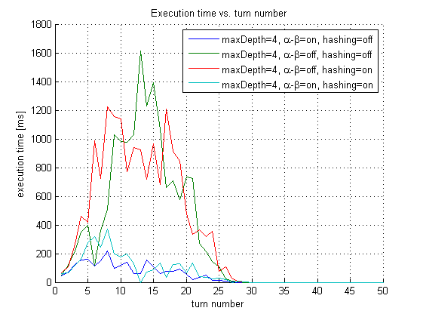
Results - Comparision
DeusExMachina's Term Project

Slide 22
Conclusion
What is Reversi?
Data structures used in project
Details of the algorithm
Results
DeusExMachina's Term Project

Slide 23
References
Binkley, Kevin J., Ken Seehart, and Masafumi Hagiwara. ”A study ofartificial neural network architectures for Othello evaluation functions.”Information and Media Technologies 2.4 (2007): 1129-1139
Buro, Michael. ”Logistello: A strong learning othello program.” 19thAnnual Conference Gesellschaft fr Klassifikation eV. 1995
Buro, Michael. ”The evolution of strong Othello programs.” Entertain-ment Computing. Springer US, 2003. 81-88
Lee, Kai-Fu, and Sanjoy Mahajan. ”BILL: a table-based, knowledge-intensive othello program.” (1986)
DeusExMachina's Term Project

Slide 24
References
Rosenbloom, Paul S. ”A world-championship-level Othello program.”Artificial Intelligence 19.3 (1982): 279-320
Wikipedia contributors. Reversi. Wikipedia, The FreeEncyclopedia. December 3, 2015, 16:36 UTC. Available at:https://en.wikipedia.org/w/index.php?title=Reversi&oldid=693589941.Accessed December 3, 2015
DeusExMachina's Term Project

Slide 25

Any Questions?
DeusExMachina's Term Project

